Slide 1
Chapter 12 SQL Application Programming Techniques Using C and Java

Slide 2
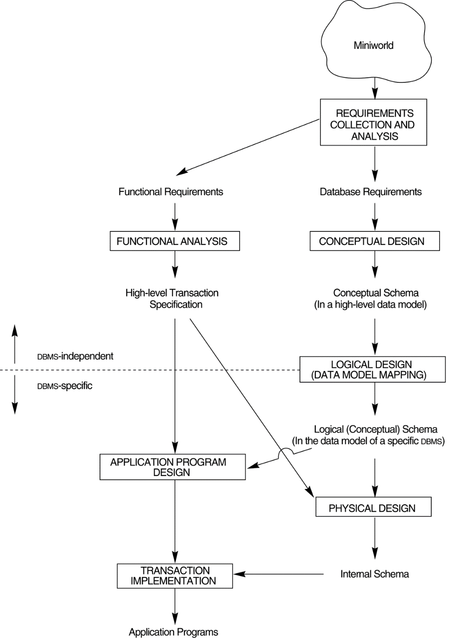
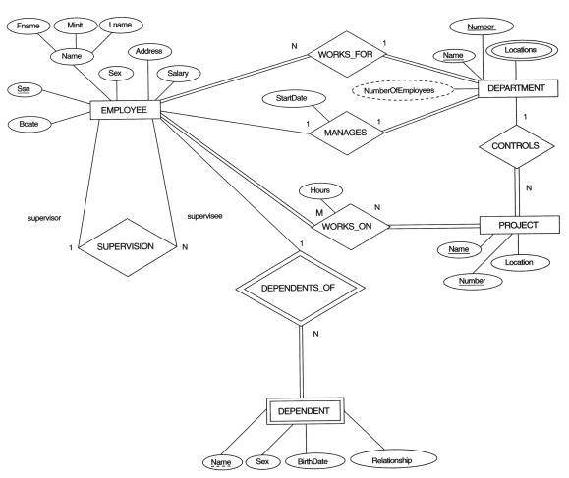
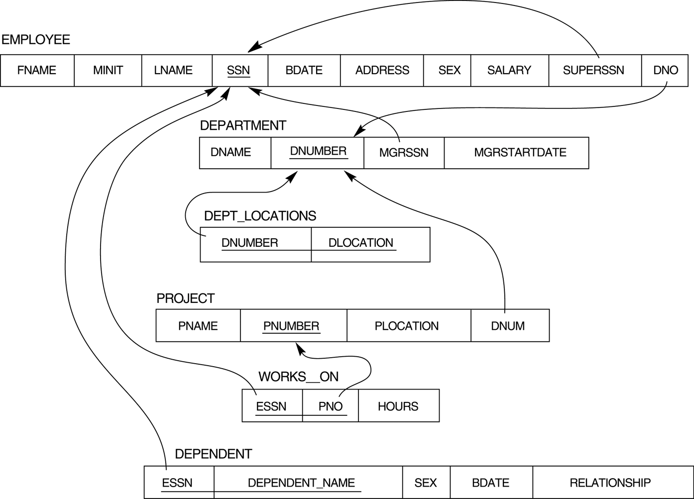

Main phases of database system design
Data Requirements
Conceptual design
(ER Model)
Ch.7
Conceptual schema
Ch.8
Logical design
(Relational Model)
Ch.4
Logical schema
Ch.12
Physical design

Slide 3

Construction and Operation
Ch. 12: Database programming
- embedded/dynamic SQL
- function call
- stored procedure and function
AP
…
Stored procedure & function
construct
SQL
Define DB
Load data
Interactive
DB
(SQL)
DB System
Ch. 4: SQL
Data Definition Language
> base table, view
Ch. 5: SQL
Data Manipulation Language
> Query: SELECT
> Update: INSERT, DELETE, UPDATE

Slide 4
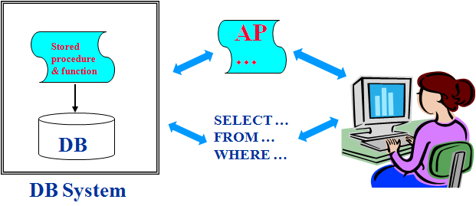
Objectives
To access a database from an application program (as opposed to interactive interfaces)
12.1 Database Programming
12.2 Embedded/dynamic SQL and SQLJ
12.3 Functions Calls, SQL/CLI and JDBC
12.4 Stored Procedures, SQL/PSM
12.5 Comparing the Three Approaches
Emb./dyn. SQL
function call

Slide 5
Database Programming Approaches
Embedded SQL
SQL statements are embedded in a general-purpose programming language, e.g., C, Java, Pascal
Call Level Interface (CLI)
library of database functions
available to the host language for database calls; known as an API
A brand new, full-fledged language
stored procedures and functions
minimizes impedance mismatch

Slide 6
Impedance Mismatch
Incompatibilities between a host programming language and the database model, e.g.,
type mismatch and incompatibilities
DATE, TIME, TIMESTAMP, etc.
requires a new binding for each language
Set-at-a-time vs. record-at-a-time processing
need special iterators to loop over query results and manipulate individual values
…
…
…
…
…
…
FOR i=1 to n
{
…
…
}
SELECT *
FROM …
WHERE …
…
…
EMPLOYEE
RESULT
C, Java
SQL

Slide 7
Steps in Database Programming
Client program opens a connection to the database server
Client program submits queries to and/or updates the database
When database access is no longer needed, client program terminates the connection
1. Connection
2. Query/update
Stored procedure & function
AP
…
…
3. Results
Embedded/dynamic SQL
Call Level Interface (CLI)
4. Disconnect
DB
Client
DB Server

Slide 8
Embedded SQL
Most SQL statements can be embedded in a general-purpose host programming language such as C, Java, Pascal
An embedded SQL statement is distinguished from the host language statements by EXEC SQL and a matching END-EXEC (or “;” semicolon)
shared variables (used in both languages) usually prefixed with a colon (:) in SQL
EXEC SQL
select FNAME, LNAME, ADDRESS, SALARY
into :fname, :lname, :address, :salary
from EMPLOYEE where SSN = :ssn
END-EXEC
…
EXEC SQL
… …
END-EXEC
…
embed
AP: C, Java, …

Slide 9
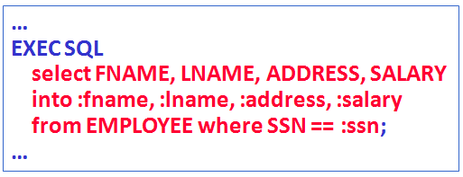
Example: Variable Declaration in Language C
Variables inside DECLARE are shared and can appear (while prefixed by a colon) in SQL statements
SQLCODE is used to communicate errors/exceptions between the database and the program
int loop;
EXEC SQL BEGIN DECLARE SECTION;
varchar lname[16], fname[16], …;
char ssn[10], bdate[40], …;
int dno, salary;
int SQLCODE, …;
EXEC SQL END DECLARE SECTION;

Slide 10
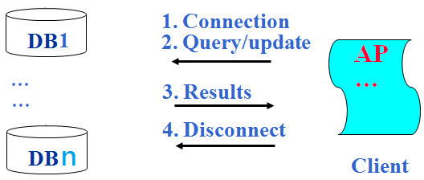
SQL Commands for Connecting to a Database
Connection
multiple connections are possible but only one is active
CONNECT TO server-name AS connection-name
AUTHORIZATION user-account-info;
Change from an active connection to another one
SET CONNECTION connection-name;
Disconnection
DISCONNECT connection-name;

Slide 11
Example: Embedded SQL in C
loop = 1;
while (loop) {
prompt (“Enter SSN: “, ssn);
EXEC SQL
select FNAME, LNAME, ADDRESS, SALARY
into :fname, :lname, :address, :salary
from EMPLOYEE where SSN = :ssn;
if (SQLCODE == 0) printf(fname, lname, …);
else printf(“SSN does not exist: “, ssn);
prompt(“More SSN? (1=yes, 0=no): “, loop);
}
Shared variables
Check success or not
Shared variables

Slide 12
Cursor for Multiple Tuples
A cursor (iterator) is needed to process multiple tuples
FETCH commands move the cursor to the next tuple
CLOSE CURSOR indicates that the processing of query results has been completed
Embedded SQL
…
while(…) {
FETCH from EMP …
…
}
…
…
DB
…
…
…
multiple tuples
EMP
cursor
C Program

Slide 13
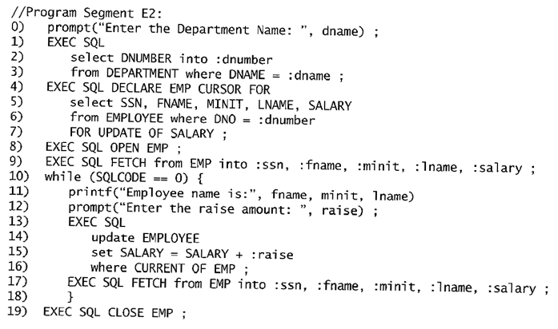
Program segment E2, a C program segment that uses cursors with embedded SQL for update purposes.
// declare a cursor EMP
Fetch
Fetch
close

Slide 14

Embedded SQL in Java
SQLJ
a standard for embedding SQL in Java
An SQLJ translator converts SQL statements into Java (to be executed thru the JDBC interface)
Certain classes, e.g., java.sql have to be imported
SQLJ
translator
… …
… …
… …
… …
… …
… …
Java + Embedded SQL
Java

Slide 15
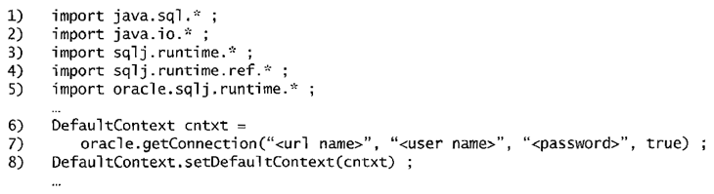
Importing classes needed for including SQLJ in JAVA programs in ORACLE, and establishing a connection and default context.

Slide 16

JAVA program variables used in SQLJ examples J1 and J2.

Slide 17
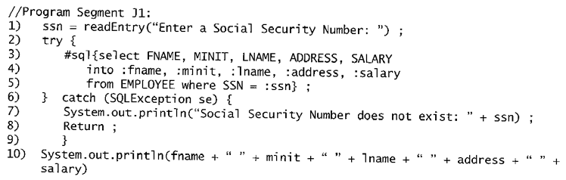
Program segment J1: A JAVA program segment with SQLJ.
Embedded SQL

Slide 18
Multiple Tuples in SQLJ
SQLJ supports two types of iterators:
named iterator: associated with a query result
positional iterator: lists only attribute types in a query result
A FETCH operation retrieves the next tuple in a query result:
fetch iterator-variable into program-variable
Embedded SQL
…
while(…) {
FETCH …
…
}
…
iterator
DB
…
…
Java Program

Slide 19
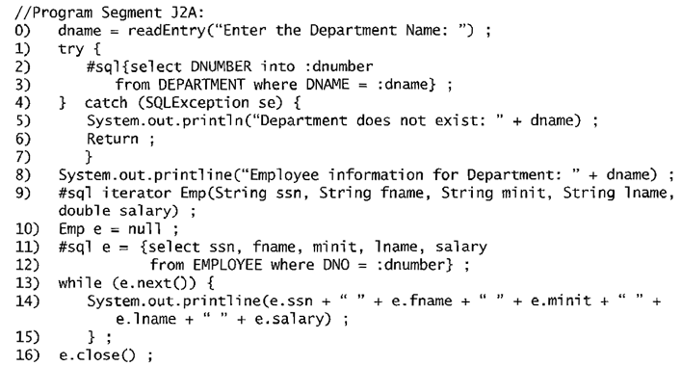
A JAVA program segment that uses a named iterator to print employee information in a particular department.
A named iterator
Retrieve from DB
Process results

Slide 20
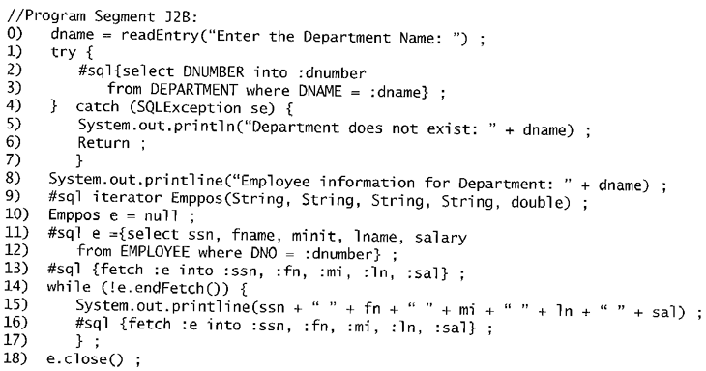
A JAVA program segment that uses a positional iterator to print employee information in a particular department.
positional iterator
Retrieve from DB
close

Slide 21
Dynamic SQL
Objective:
executing new (not previously compiled) SQL statements at run-time
a program accepts SQL statements from the keyboard at run-time
a point-and-click operation translates to certain SQL query
Dynamic update is relatively simple; dynamic query can be complex
because the type and number of retrieved attributes are unknown at compile time
AP
…
DBMS
Dynamic SQL
DB
Interactive
SQL
DB System

Slide 22
Specifying Queries at Runtime
Program segment E3:
A C program segment that uses dynamic SQL for updating table.
0. EXEC SQL BEGIN DECLARE SECTION;
1. varchar sqlupdatestring[256];
2. EXEC SQL END DECLARE SECTION;
… …
7. prompt (“Enter update command:“, sqlupdatestring);
8. EXEC SQL PREPARE sqlcommand FROM :sqlupdatestring;
9. EXEC SQL EXECUTE sqlcommand;
DBMS
AP
…
sqlupdatestring
DB

Slide 23
Database Programming with Functional Calls
Embedded SQL provides static database programming
API: dynamic database programming with a library of functions
advantage: no preprocessor needed (thus more flexible)
drawback: SQL syntax checks to be done at run-time
Connection
Query
update
Stored procedure & function
AP
…
Embedded/dynamic SQL
Call Level Interface (CLI)
e.g., SQLConnect(q1,q2, …)
Results
DB
Client
DB Server
#include stdio.h;
…
scanf(“No.: %5d”, MyNum);

Slide 24
SQL/CLI Call Level Interface
A part of the SQL standard
Provides easy access to several databases within the same program
Certain libraries (e.g., sqlcli.h for C) have to be installed and available
SQL statements are dynamically created and passed as string parameters in the calls
Call Level Interface:
#include sqlcli.h;
…
SQLConnect(p1,p2, …);
SQLExecute(stmt);
…
Embedded SQL:
…
EXEC SQL
SELECT SSN …
END-EXEC
…
No preprocessor needed
Need preprocessor
C program
C program

Slide 25
Components of SQL/CLI
Environment record
keeps track of database connections
Connection record
keep tracks of info needed for a particular connection
Statement record
keeps track of info needed for one SQL statement
Description record
keeps track of tuples
DB1
conn…
…
active
DB2
query/result
conn…
…
…
AP
DBn

Slide 26
Steps in C and SQL/CLI Programming
Load SQL/CLI libraries
Declare record handle variables for the above components (called: SQLHENV, SQLHDBC, SQLHSTMT, SQLHDEC)
Set up an environment record using SQLAllocHandle
Set up a connection record using SQLAllocHandle
Set up a statement record using SQLAllocHandle
Prepare a statement using SQL/CLI function SQLPrepare
Bind parameters to program variables via SQLBindParameter
Execute SQL statement via SQLExecute
Bind columns in a query to a C variable via SQLBindCol
Use SQLFetch to retrieve column values into C variables
…
…
…
variables
select LNAME, SALARY from EMPLOYEE
where SSN = ?
columns

Slide 27
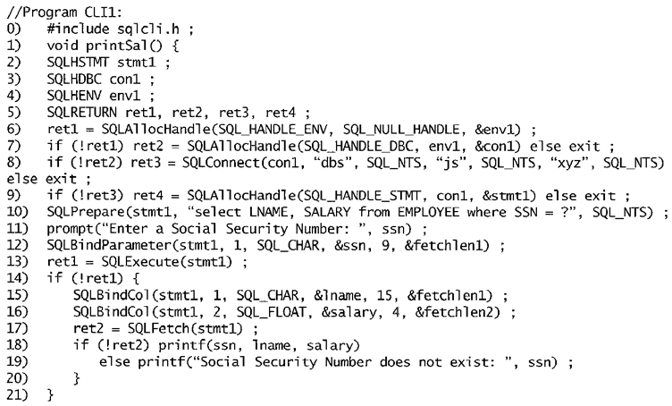
Program segment CLI1: A C program segment with SQL/CLI.
declaration
Setup records
Prepare query
Bind parameters
Bind output
Process results

Slide 28
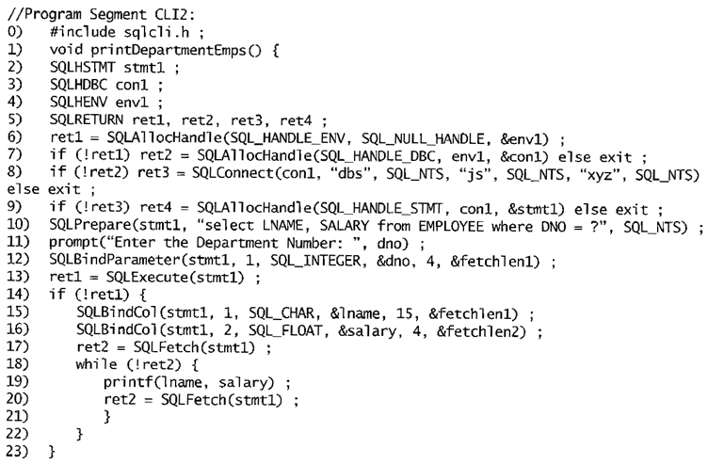
Program segment CLI2, a C program segment that uses SQL/CLI for a query with a collection of tuples in its result.
declaration
Setup records
Prepare query
Bind parameters
Bind output
Iteratively process results

Slide 29
Java Database Connectivity
JDBC: SQL connection function calls for Java programming
A Java program with JDBC functions can access any relational DBMS that has a JDBC driver
JDBC allows a program to connect to several databases (known as data sources)
DB1
active
DB2
query/result
conn…
…
…
Java +
JDBC functions
DBn

Slide 30
Steps in JDBC Database Access
Import JDBC library (java.sql.*)
Load JDBC driver: Class.forName(“oracle.jdbc.driver.OracleDriver”)
Define appropriate variables
Create a connect object (via getConnection)
Create a statement object from the Statement class:
(1) PreparedStatment
(2) CallableStatement
Identify statement parameters (to be designated by question marks)
Bind parameters to program variables
Execute SQL statement (referenced by an object) via JDBC’s executeQuery
Process query results (returned in an object of type ResultSet)
ResultSet is a 2-dimentional table

Slide 31
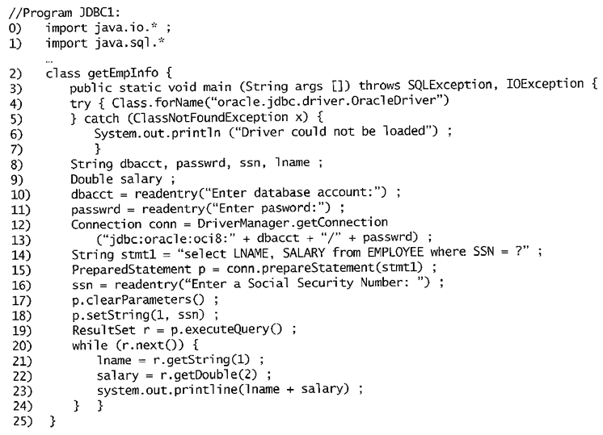
Program segment JDBC1: A JAVA program segment with JDBC.
declaration
connect
Prepare query
Bind parameter
process query results

Slide 32
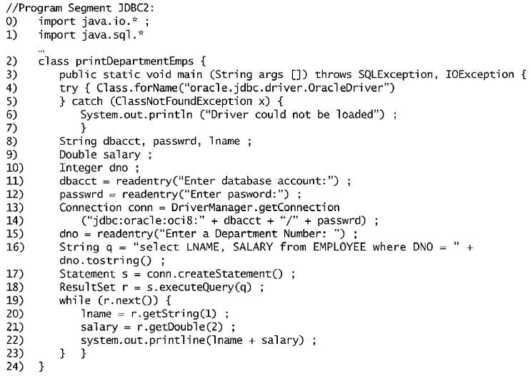
Program segment JDBC2, a JAVA program segment that uses JDBC for a query with a collection of tuples in its result.
declaration
connect
prepare query
process query results

Slide 33
Database Programming
Database programming
1. embedded/dynamic SQL
2. function call
3. stored procedure and function
…
EXEC SQL
SELECT …
END-EXEC
…
Stored procedures & functions
DeptSize(n)
{…}
1
#include …
…
SQLFetch(stmt1)
…
2
DB
3
DB System
…
DeptSize(5)
…
SQL
SELECT …
FROM …
WHERE …
Interactive

Slide 34
Database Stored Procedures
Persistent procedures/functions (modules) are stored locally and executed by the database server (as opposed to execution by clients)
Advantages:
if the procedure is needed by many applications, it can be invoked by any of them (thus reduce duplications)
execution by the server reduces communication costs
enhance the modeling power of views
…
DSize(4)
…
AP1
Stored procedures & functions
DSize(n) {…}
Invoke
Results
…
…
Invoke
…
DSize(2)
…
AP5
DB
Results
DB Server
Clients

Slide 35
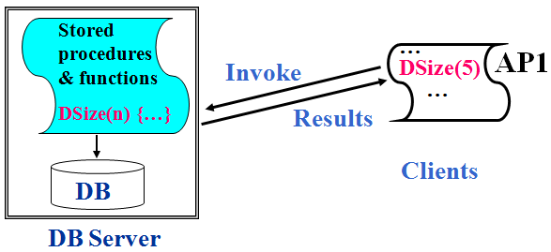
Stored Procedure Constructs
A stored procedure
CREATE PROCEDURE procedure-name (params)
local-declarations
procedure-body;
A stored function
CREATE FUNCTION fun-name (params) RETRUNS return-type
local-declarations
function-body;
Calling a procedure or function
CALL procedure-name/fun-name (arguments);

Slide 36
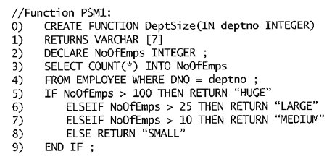
SQL Persistent Stored Modules
SQL/PSM
part of the SQL standard for writing persistent stored modules (PSM)
SQL + stored procedures/functions + additional programming constructs
e.g., branching and looping statements
enhance the power of SQL
SQL
Additional program control

Slide 37
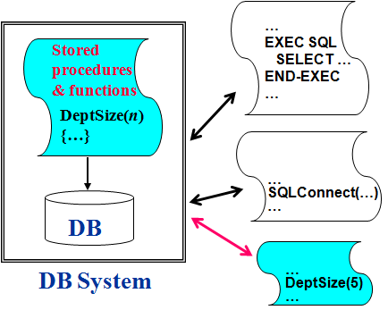
Comparing the Three Approaches
Embedded SQL
Advantages
Syntax errors are checked at compile time
Program is more readable
Disadvantage
Loss of flexibility in changing the query at runtime
Library of Function Calls
Advantage
Flexibility: query can be generated at runtime
Disadvantage
Complex programming: programmer needs to check for runtime errors
Database Programming Language
Advantage
No impedance mismatch problem
Disadvantage
Need to learn a new language

Slide 38
Summary
A database may be accessed via
an interactive interface
application programs
Connection
Query/
Update
AP
…
Embedded/dynamic SQL
Call Level Interface
Stored procedure & function
Stored procedures & functions
Results
Interactive
DB
SQL
Canned St.
Command
DB System

